Slide 1
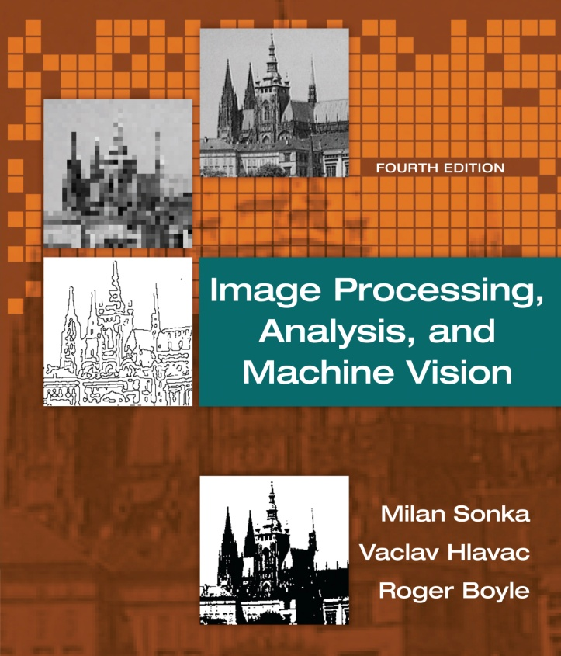

Chapter 4
Image Processing, Analysis, and Machine Vision, 4th Edition Sonka, Hlavac & Boyle
Data structure for image analysis

Slide 2
Levels of image data representation
Image Processing, Analysis, and Machine Vision, 4th Edition Sonka, Hlavac & Boyle
The representation can be stratified in four levels [Ballard and Brown, 1982]
The lowest representational level: iconic (符號的) images
This level consists of image containing original data.
The second level: segmented (分割的) images
Parts of images are joined into groups that probably belong to the same objects.
The third level: geometric (幾何的) representations
These representations hold knowledge about 2D and 3D shapes.
The fourth level: relational (關聯的) models
These models give us the ability to treat data more efficiently and at a higher level of abstraction.
There are no strict borders between these levels.
These four levels are ordered from signals at a low level of abstraction to the description that a human can perceive.

Slide 3
Traditional image data structures
Image Processing, Analysis, and Machine Vision, 4th Edition Sonka, Hlavac & Boyle
Matrices (矩陣)
The most common data structure for low-level representation of an image.
Image information in the matrix is accessible through the co-ordinates of a pixel that correspond with row and column indices.
The matrix is a full representation of the image, independent of the contents of image data.
Spatial relation (空間關係)
The space is two-dimensional in the case of an image.
One very natural spatial relation is the neighborhood relation.

Slide 4
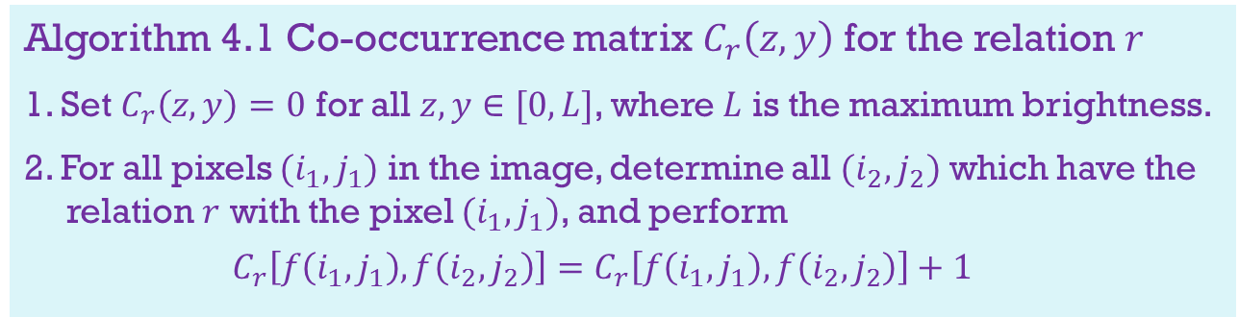

Matrices
Image Processing, Analysis, and Machine Vision, 4th Edition Sonka, Hlavac & Boyle
Global information of images
Histogram is the most popular example of global information.
Co-occurrence matrix (相互關係矩陣或共生矩陣) is another example of global information. [Pavlidis, 1982]
Given an image $f(i,j)$ and if pixel $(i_{1},j_{1})$ has intensity $z$ and pixel $(i_{2},j_{2})$ has intensity $y$, then the co-occurrence matrix of $f(i,j)$can be obtained from algorithm 4.1.
Algorithm 4.1 Co-occurrence matrix $C_{r}\left(z,y\right)$ for the relation $r$
1. Set $C_{r}\left(z,y\right)=0$ for all $z,y∈[0,L]$, where $L$ is the maximum brightness.
2. For all pixels $(i_{1},j_{1})$ in the image, determine all $(i_{2},j_{2})$ which have the relation $r$ with the pixel $(i_{1},j_{1})$, and perform
$$C_{r}\left[f\left(i_{1},j_{1}\right),f\left(i_{2},j_{2}\right)\right]=C_{r}\left[f\left(i_{1},j_{1}\right),f\left(i_{2},j_{2}\right)\right]+1$$

Slide 5

Matrices
Image Processing, Analysis, and Machine Vision, 4th Edition Sonka, Hlavac & Boyle
An example of Algorithm 4.1
If the relation $r$ is to be a southern or eastern 4-neighbor of the pixel $(i_{1},j_{1})$, or identity (see p. 103) , elements of the co-occurrence matrix have some interesting properties.
Diagonal elements of the matrix $C_{r}\left(k,k\right)$ are equal to the area of the regions in the image with brightness $k$, and so correspond to the histogram.
Off-diagonal elements $C_{r}\left(k,j\right)$ are equal to the length of the border dividing regions with brightnesses $k$and $j$, $k≠j$.
For instance,
In an image with low contrast, the elements of the co-occurrence matrix that are far from the diagonal are equal to zero or are very small.
For high-contrast images, the opposite is true.

Slide 6
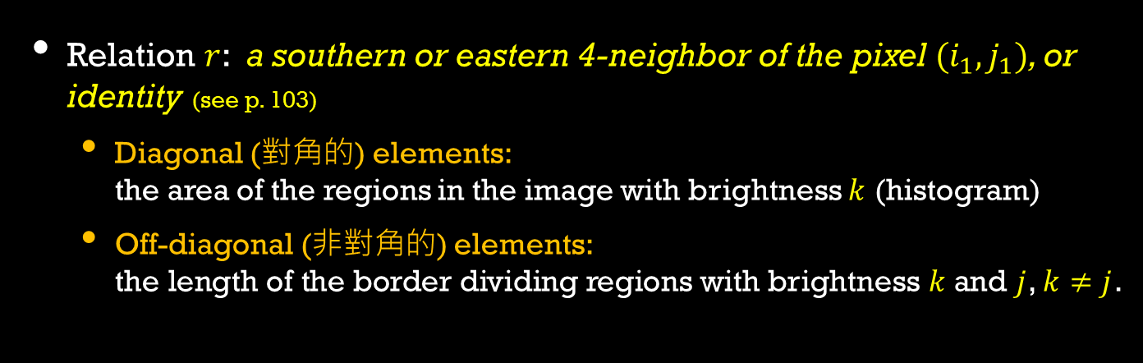

An example of Algorithm 4.1
Relation $r$: a southern or eastern 4-neighbor of the pixel $(i_{1},j_{1})$, or identity (see p. 103)
Diagonal (對角的) elements: the area of the regions in the image with brightness $k$ (histogram)
Off-diagonal (非對角的) elements: the length of the border dividing regions with brightness $k$and $j$, $k≠j$.
2 | 2 | 2 | 2 | 2
2 | 1 | 1 | 1 | 2
2 | 1 | 0 | 1 | 2
2 | 1 | 1 | 1 | 2
2 | 2 | 2 | 2 | 2
$\begin{matrix} & \begin{matrix}0 & 1 & 2\end{matrix} \\ \begin{matrix}0 \\ 1 \\ 2\end{matrix} & \left[\begin{matrix}1 & 1 & 0 \\ 2 & 8 & 5 \\ 0 & 6 & 16\end{matrix}\right]\end{matrix}$
Image
Co-occurrence matrix

Slide 7
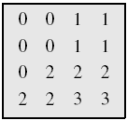
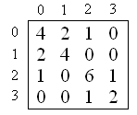
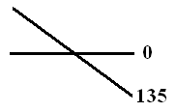
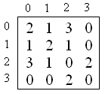
Another example: r = (orientation, distance)
Image:
r = (0, 1),
C (0, 1) =
r = (135, 1),
C (135, 1) =
r = (orientation, distance)

Slide 8
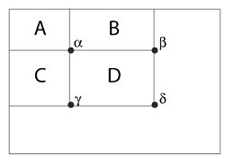
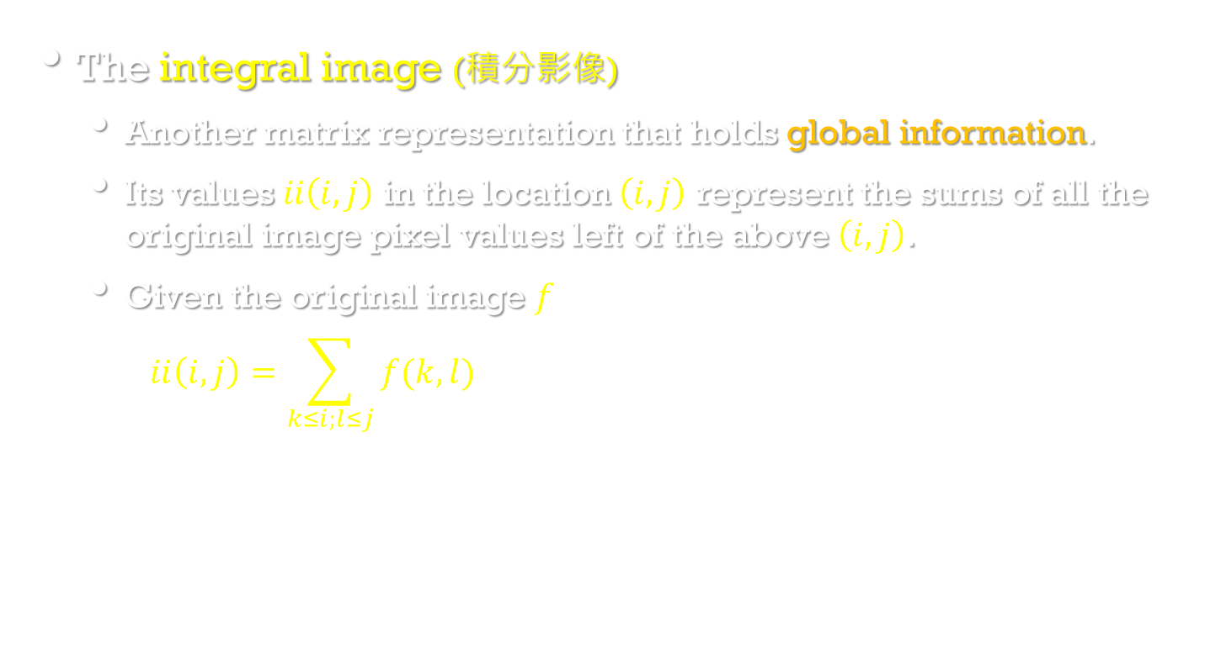
Matrices
Image Processing, Analysis, and Machine Vision, 4th Edition Sonka, Hlavac & Boyle
The integral image (積分影像)
Another matrix representation that holds global information.
Its values $ii\left(i,j\right)$ in the location $\left(i,j\right)$ represent the sums of all the original image pixel values left of the above $\left(i,j\right)$.
Given the original image $f$
$$ii\left(i,j\right)=\sum_{k≤i;l≤j}{f(k,l)}$$

Slide 9
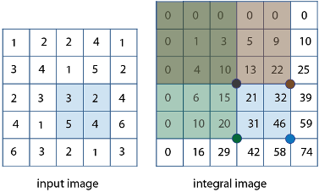
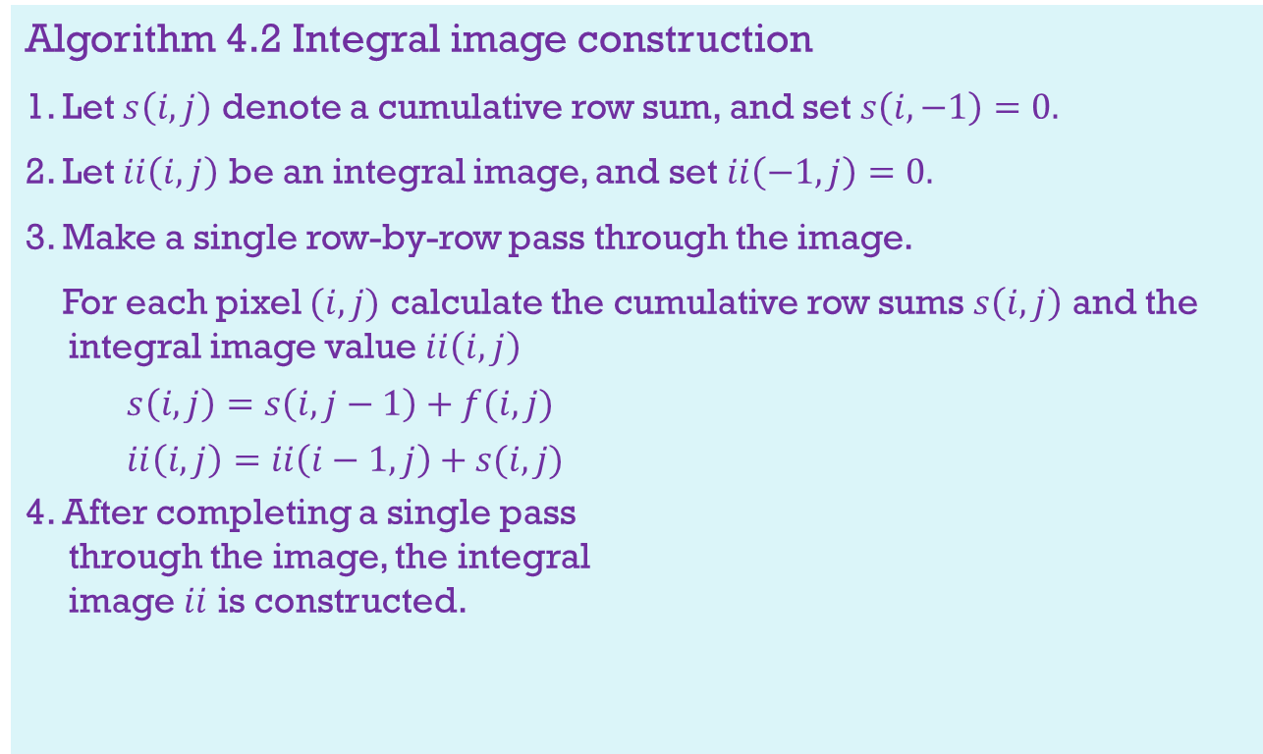
Matrices
Algorithm 4.2 Integral image construction
1. Let $s\left(i,j\right)$ denote a cumulative row sum, and set $s\left(i,−1\right)=0.$
2. Let $ii\left(i,j\right)$ be an integral image, and set $ii\left(−1,j\right)=0.$
3. Make a single row-by-row pass through the image.
For each pixel $(i,j)$ calculate the cumulative row sums $s\left(i,j\right)$ and the integral image value $ii\left(i,j\right)$
$$s\left(i,j\right)=s\left(i,j−1\right)+f(i,j)$$
$$ii\left(i,j\right)=ii\left(i−1,j\right)+s(i,j)$$
4. After completing a single pass through the image, the integral image $ii$ is constructed.

Slide 10

Matrices
Image Processing, Analysis, and Machine Vision, 4th Edition Sonka, Hlavac & Boyle
Calculation of rectangle features from an integral image.
The sum of pixels within rectangle D can be obtained using four array references.
$$Dsum=ii\left(δ\right)+ii\left(α\right)−(ii\left(β\right)+ii\left(γ\right))$$
where $ii\left(δ\right)$ is the value of the integral image at point $δ$.
For example, 46 +10 – (22 + 20) = 14 = 3 + 2 + 5 + 4

Slide 11
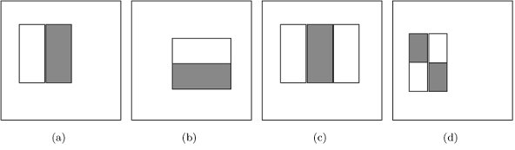
Matrices
Image Processing, Analysis, and Machine Vision, 4th Edition Sonka, Hlavac & Boyle
Rectangle-based features may be calculated from an integral image by subtraction of the sum of the shaded rectangle(s) from the non-shaded rectangle(s).
The figure shows (a, b) two-rectangle (二個矩形), (c) three-rectangle, and (d) four-rectangle features.

Slide 12
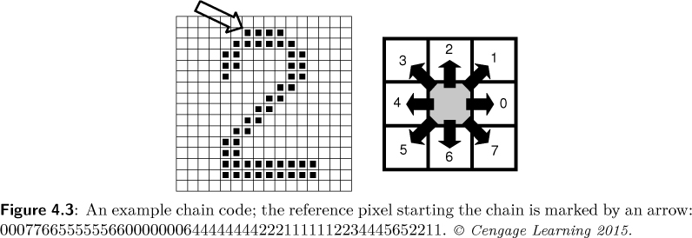
Traditional image data structures
Image Processing, Analysis, and Machine Vision, 4th Edition Sonka, Hlavac & Boyle
Chains
Chains are used for the description of object borders in computer vision.
For example: chain codes (鏈碼) (8-neighborhoods)

Slide 13
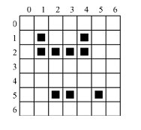
Chains
Image Processing, Analysis, and Machine Vision, 4th Edition Sonka, Hlavac & Boyle
Another example: run length coding (運行長度編碼)
Run length coding has been used to represent strings of symbols in an image matrix.
Run length coding records only areas that belong to objects in the image.
The area is then represented as a list of lists (由串列組成的串列).
The code of this example is ((1 1 1 4 4)(2 1 4)(5 2 3 5 5))
For binary images:
((Row#, begin col., end col. .... begin col., end col.)
…………………………………………………….
(Row#, begin col., end col. .... begin col., end col.))

Slide 14
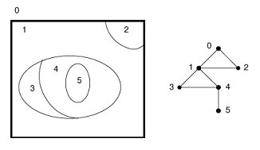
Traditional image data structures
Image Processing, Analysis, and Machine Vision, 4th Edition Sonka, Hlavac & Boyle
Topological data structure
Graph
A weighted graph is a graph in which values are assigned to arcs, to nodes, or to both.
The region adjacency graph (區域鄰接圖) is typical of this class of data structure.
For example,

Slide 15
Topological data structure
Image Processing, Analysis, and Machine Vision, 4th Edition Sonka, Hlavac & Boyle
The property of the region adjacency graph
If a region enclosed other regions, then the part of the graph corresponding with the areas inside can be separated by a cut in the graph.
Nodes of degree 1 represent simple holes.
For example, node 5.

Slide 16
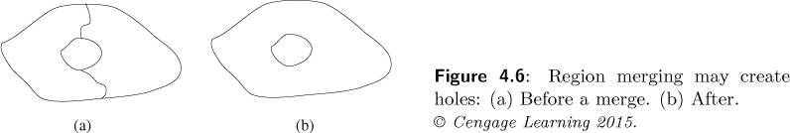
Topological data structure
Image Processing, Analysis, and Machine Vision, 4th Edition Sonka, Hlavac & Boyle
The region adjacency graph is usually created from the region map.
Region map is a matrix of the same dimensions as the original image matrix whose elements are identification labels of the regions.
The region adjacency graph (區域鄰接圖) can be used to approach region merging.
The region merging may create holes. (The topological property changes)

Slide 17
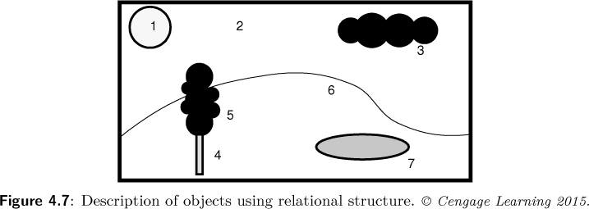
Relational structures
Image Processing, Analysis, and Machine Vision, 4th Edition Sonka, Hlavac & Boyle
Relational databases (關聯式資料庫) can also be used for representation of information from an image.
The image should be segmented (分割) first.
The information of objects, the important parts of the image, are then recorded in the relational table (關係表).

Slide 18
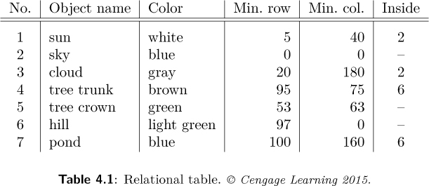
Relational structures
Image Processing, Analysis, and Machine Vision, 4th Edition Sonka, Hlavac & Boyle
Relational table
Relations are recorded in the form of table.

Slide 19
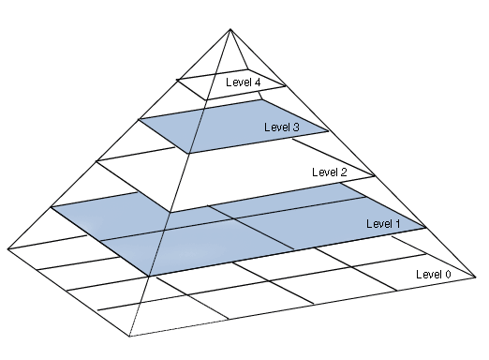
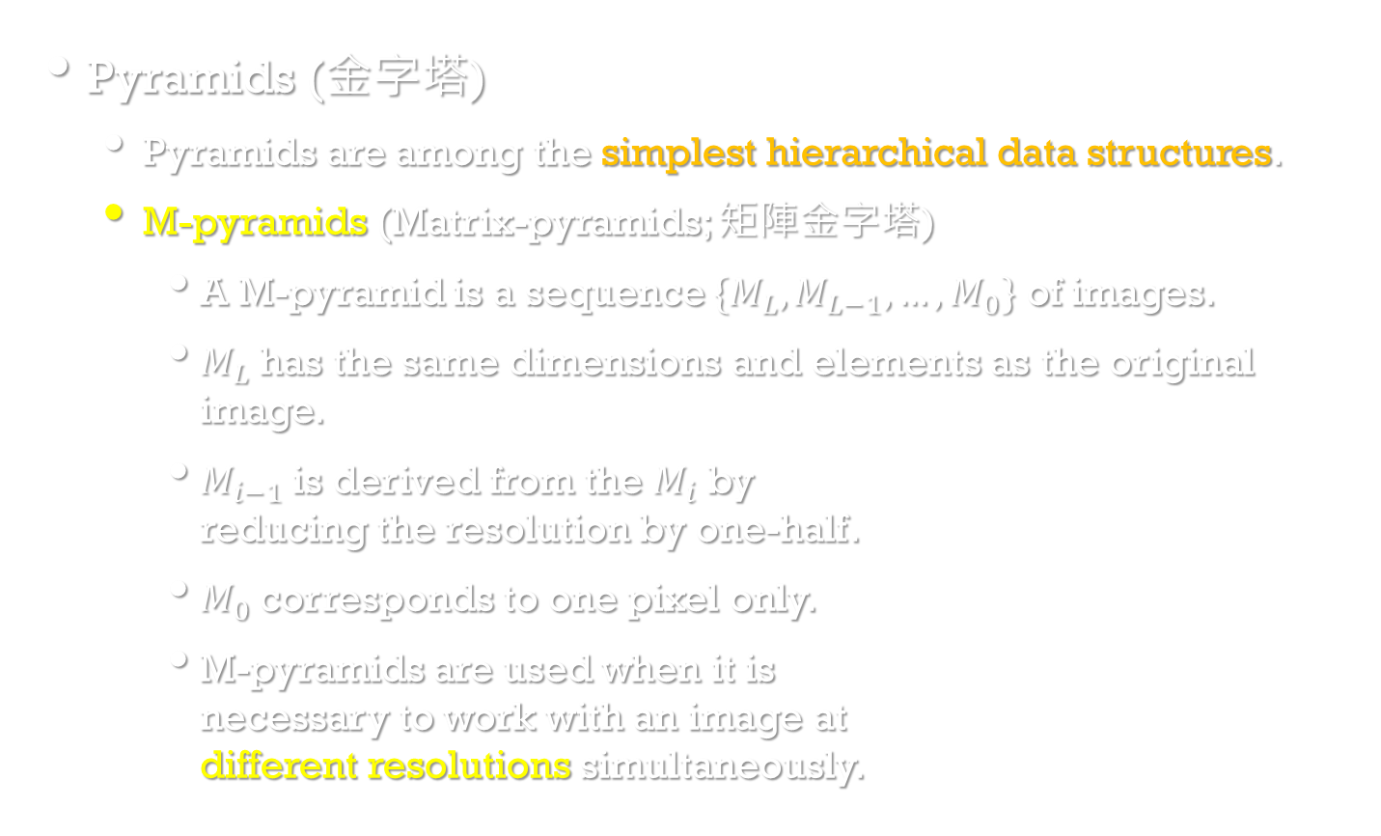


Hierarchical (階層式) data structures
Image Processing, Analysis, and Machine Vision, 4th Edition Sonka, Hlavac & Boyle
Pyramids (金字塔)
Pyramids are among the simplest hierarchical data structures.
M-pyramids (Matrix-pyramids; 矩陣金字塔)
A M-pyramid is a sequence $\{M_{L},M_{L−1},…,M_{0}\}$ of images.
$M_{L}$ has the same dimensions and elements as the original image.
$M_{i−1}$ is derived from the $M_{i}$ by reducing the resolution by one-half.
$M_{0}$ corresponds to one pixel only.
M-pyramids are used when it is necessary to work with an image at different resolutions simultaneously.
$$M_{0}$$
$$M_{L}$$

Slide 20
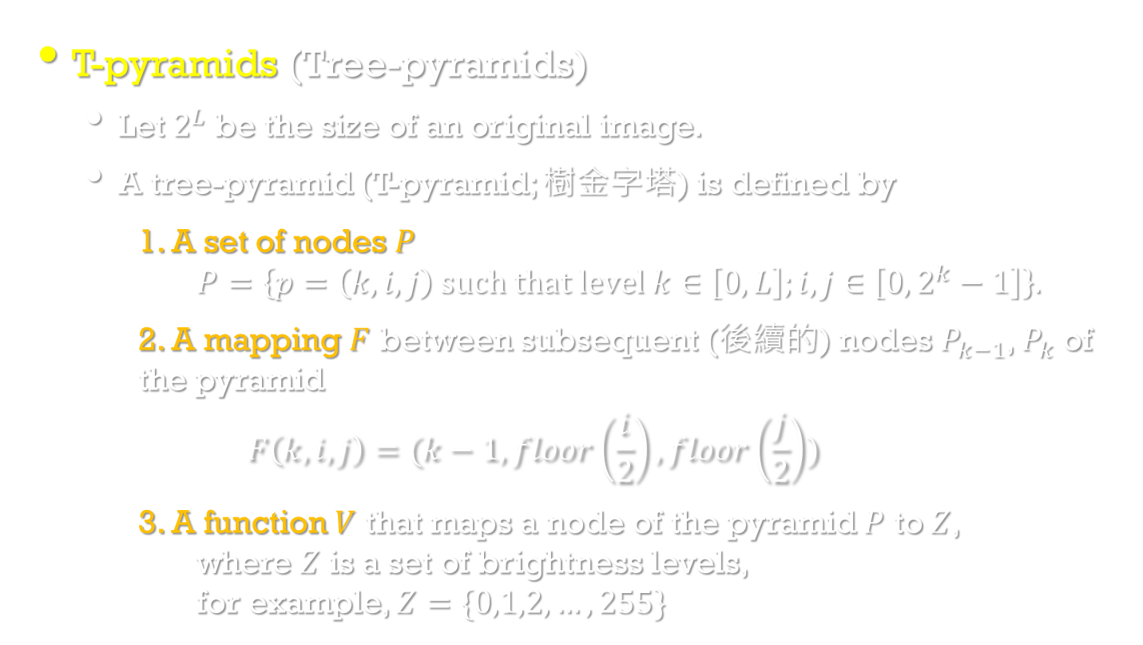
Hierarchical data structures
Image Processing, Analysis, and Machine Vision, 4th Edition Sonka, Hlavac & Boyle
T-pyramids (Tree-pyramids)
Let $2^{L}$ be the size of an original image.
A tree-pyramid (T-pyramid; 樹金字塔) is defined by
1. A set of nodes $P$ $P=\left\{p=\left(k,i,j\right) such that level k∈\left[0,L\right];i,j∈\left[0,2^{k}−1\right]\right\}.$
2. A mapping $F$ between subsequent (後續的) nodes $P_{k−1}$, $P_{k}$ of the pyramid
$$F\left(k,i,j\right)=(k−1, floor\left(\frac{i}{2}\right), floor\left(\frac{j}{2}\right))$$
3. A function $V$ that maps a node of the pyramid $P$ to $Z$, where $Z$ is a set of brightness levels, for example, $Z=\{0,1,2,…,255\}$

Slide 21
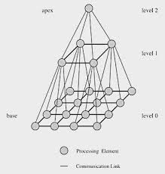
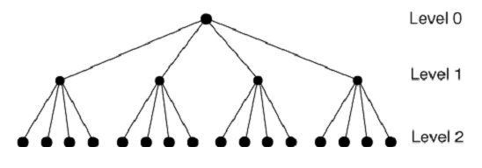
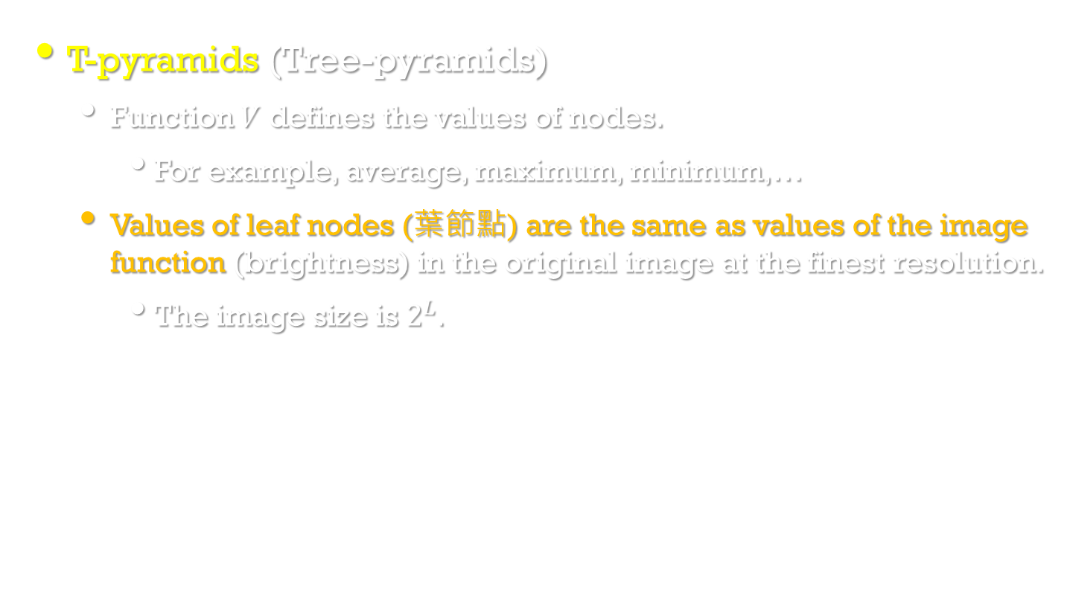
Hierarchical data structures
Image Processing, Analysis, and Machine Vision, 4th Edition Sonka, Hlavac & Boyle
T-pyramids (Tree-pyramids)
Function $V$ defines the values of nodes.
For example, average, maximum, minimum,…
Values of leaf nodes (葉節點) are the same as values of the image function (brightness) in the original image at the finest resolution.
The image size is $2^{L}.$

Slide 22
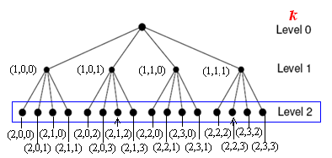
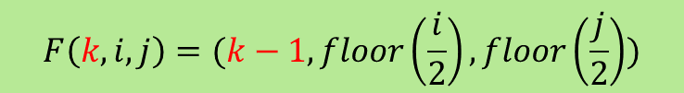
Tree-pyramids
$$F\left(k,i,j\right)=(k−1, floor\left(\frac{i}{2}\right), floor\left(\frac{j}{2}\right))$$
defines the values of nodes, e.g., average, maximum, minimum
Z: a set of brightness levels
Leaf nodes have pixel brightness values

Slide 23
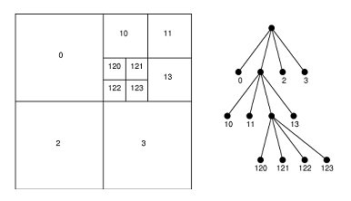
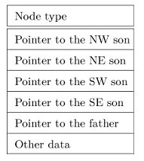
Hierarchical data structures
Image Processing, Analysis, and Machine Vision, 4th Edition Sonka, Hlavac & Boyle
Quadtrees (四元樹)
Quadtrees are modifications of T-pyramids.
Every node of the tree except the leaves has four children.
Record describing a quadtree node

Slide 24
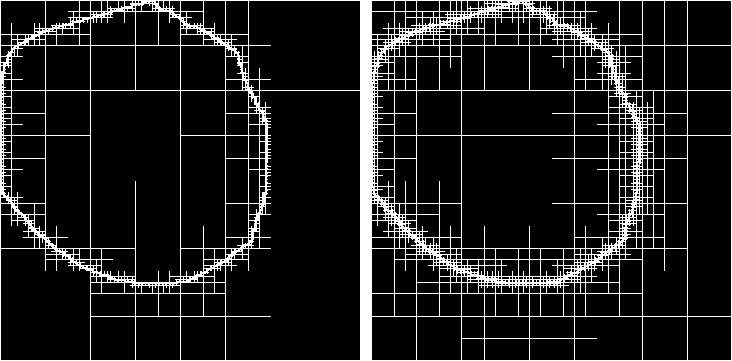
Hierarchical data structures
http://cybertron.cg.tu-berlin.de/pdci11ws/gdi/

Slide 25
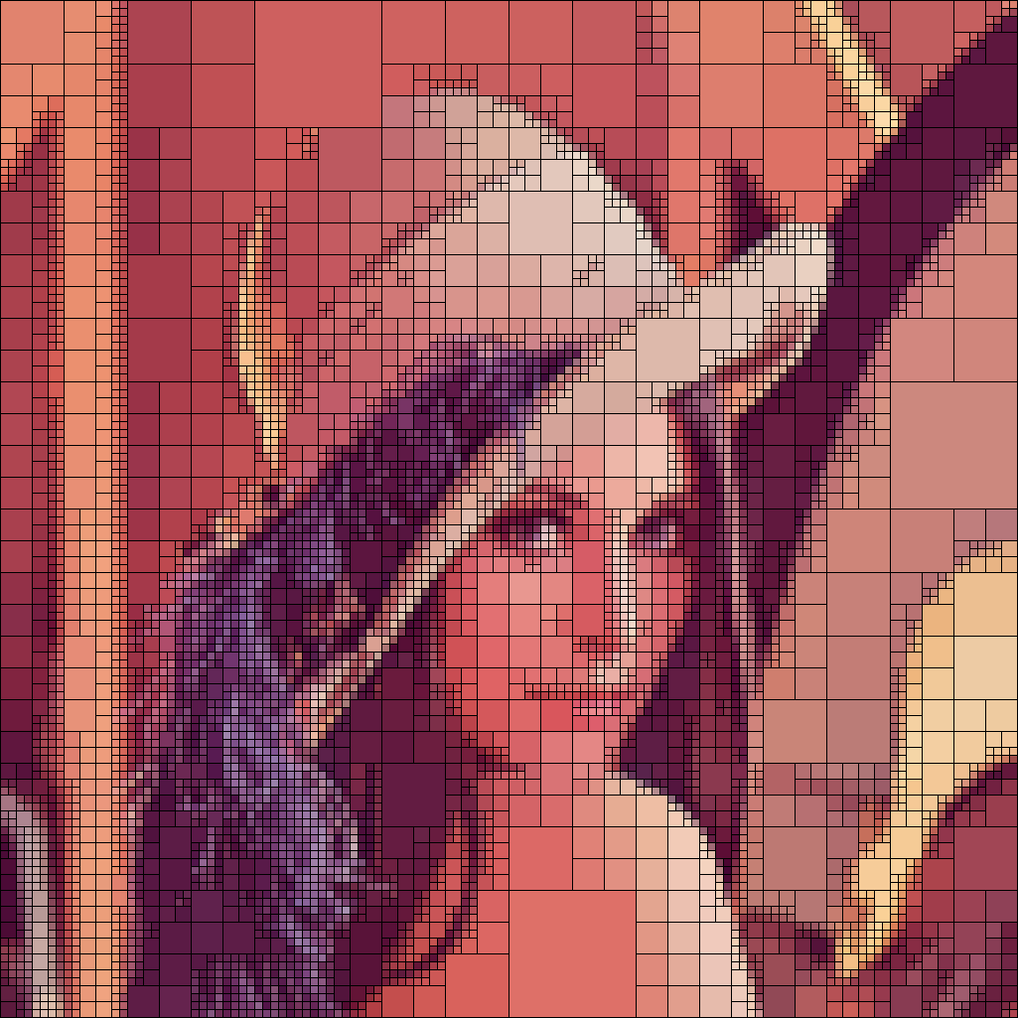
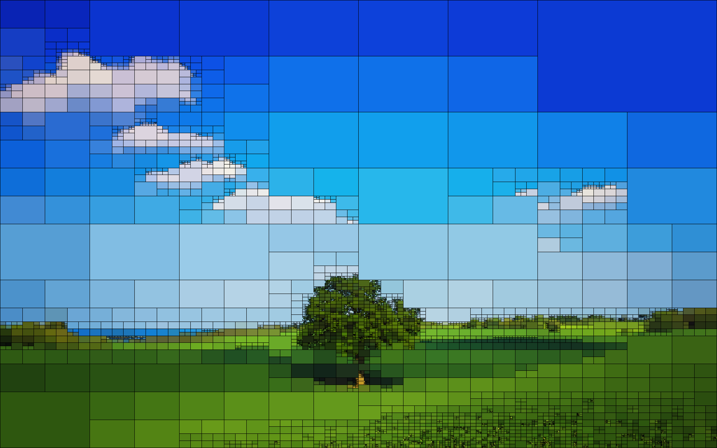
Computer art based on quadtrees
https://pythonawesome.com/computer-art-based-on-quadtrees/

Slide 26
Hierarchical data structures
Advantage
An advantage of image representation by means of quadtrees is the existence of simple algorithms for addition of images, computing object areas, and statistical moments.
Disadvantage
The main disadvantages of quadtrees and pyramid hierarchical representations is their dependence on the position, orientation, and relative size of objects.
Two similar images with just very small differences can have very different pyramid or quadtree representations.

Slide 27
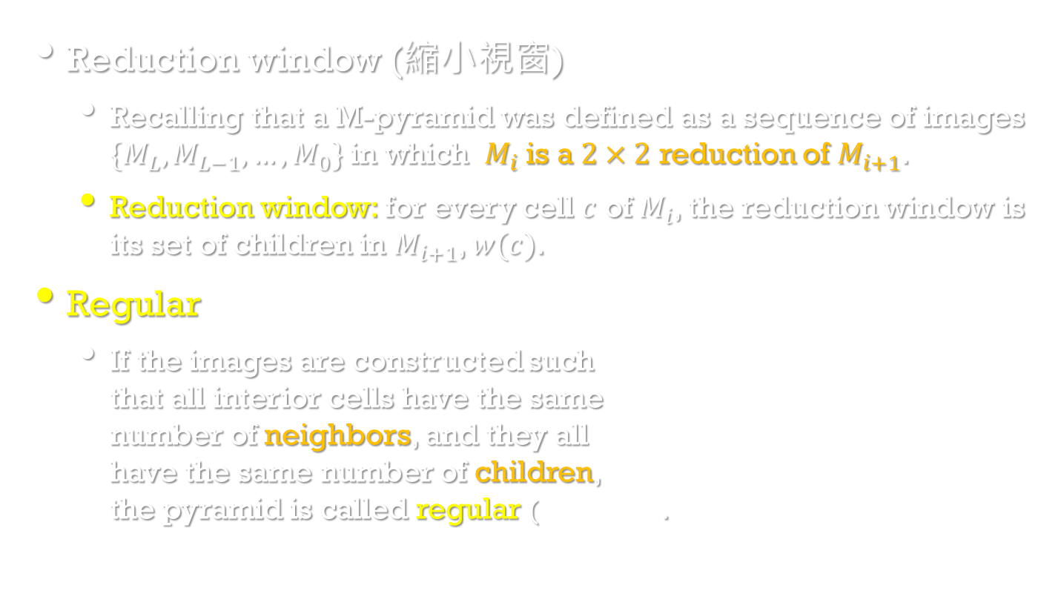

Other pyramidal structures
Image Processing, Analysis, and Machine Vision, 4th Edition Sonka, Hlavac & Boyle
Reduction window (縮小視窗)
Recalling that a M-pyramid was defined as a sequence of images $\{M_{L},M_{L−1},…,M_{0}\}$ in which $M_{i}$ is a $2×2$ reduction of $M_{i+1}$.
Reduction window: for every cell $c$ of $M_{i}$, the reduction window is its set of children in $M_{i+1}$, $w(c)$.
Regular
If the images are constructed such that all interior cells have the same number of neighbors, and they all have the same number of children, the pyramid is called regular (有規律的).
$$M_{0}$$
$$M_{L}$$

Slide 28
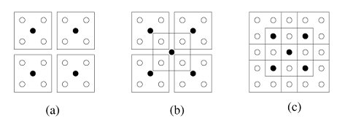
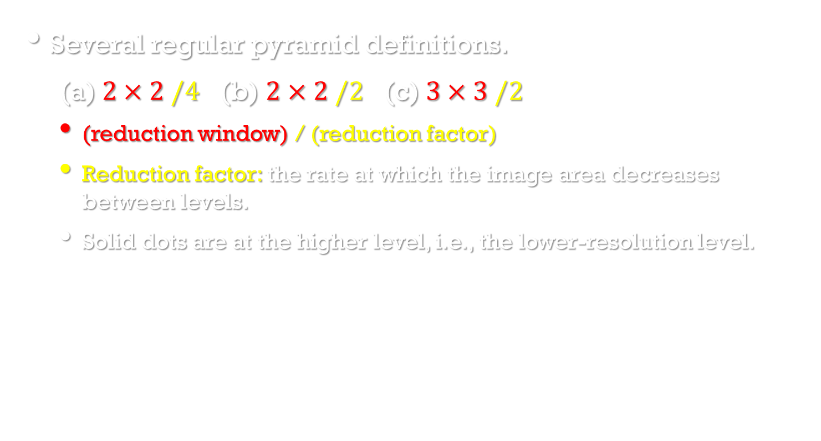
Other pyramidal structures
Image Processing, Analysis, and Machine Vision, 4th Edition Sonka, Hlavac & Boyle
Several regular pyramid definitions.
(a)$2×2 /4$ (b) $2×2 /2$ (c)$3×3 /2$
(reduction window) / (reduction factor)
Reduction factor: the rate at which the image area decreases between levels.
Solid dots are at the higher level, i.e., the lower-resolution level.

